Slide 1
Planning for the Optimal Production and Design of a High-End Rowing Machine
IE 505
Team Kappa
Sarthak Devmurari
Duc Nguyen
Arka Chowdhury
Joseph Szabo
Mit Rami
Vaibhav Shah

Slide 2

Introduction
Sharp Tooling Company is a specialty machine shop that offers dependable service and personalized service for each of their customers. They distinguish their work by the quality of their products and the efficiency of their service. Sharp Tooling Company has experience in many different industries that has prepared them to take on a variety of projects.
Problem statement:
The production of the actuator is sluggish, inefficient, and costly
The total production time and cost needs to be optimized to meet production and sales demand, and the need for quicker and more cost-efficient production
Sharp also faces heavy competition, as the team is assisting them against the current most popular rowing machine on the market as well as various other advanced simulators and rowing tanks.
Notes:
DUC

Slide 3

Project objectives
Determine the production time and costs for all the items in the actuator assembly, and then using this data, forecast their future demand, and create an optimal production plan for Sharp
● Collecting all part information - referencing their existing job routings, part programs,
tooling used, materials.
● Determine cost and time investments required for part production and assembly
● Get machine and system quotes based on our findings
● Evaluate our options and run 2 to 3 different scenarios to determine yield and cost.
● Process planning and machine scheduling of the product.

Slide 4

Approach
Predict the demand using a subjective forecasting method (Delphi method)
Collecting the necessary data of total raw material required, the ordering cost, fixed costs per unit, interest rate, inventory costs
Analyze time simulation by using DMG software
Applying the time analysis method using the MATLAB
Scheduling by using Gantt-Chart
Using the Program Evaluation Review Technique (PERT) method
Using EOQ model to calculate the optimum lot size
Using the Push-Pull methods to make the practical use of the EOQ output
Using the Learning Curve to determine the reduction in time that will occur in assembly
Identify the Production Cost

Slide 5

Key Results
With Delphi method we got the forecasting demand for 2 years.
Observed the total time to manufacture one unit
Evaluated the total manufacturing costs
Found the Lot Sizing problem using EOQ and Silverman
Time Analysis
PERT Analysis
Effects of Learning Curve
Notes:
joe

Slide 6

Forecasting
The product is a new innovative product going to be launched first time in market
Hence we used Delphi method to determine the demand of the product for the first two years
We discussed with the company’s experts and employees about the estimation of demand
For more accurate estimation of demand we will have to wait for 6 months to use those values and then use objective methods for forecasting
Notes:
joe

Slide 7
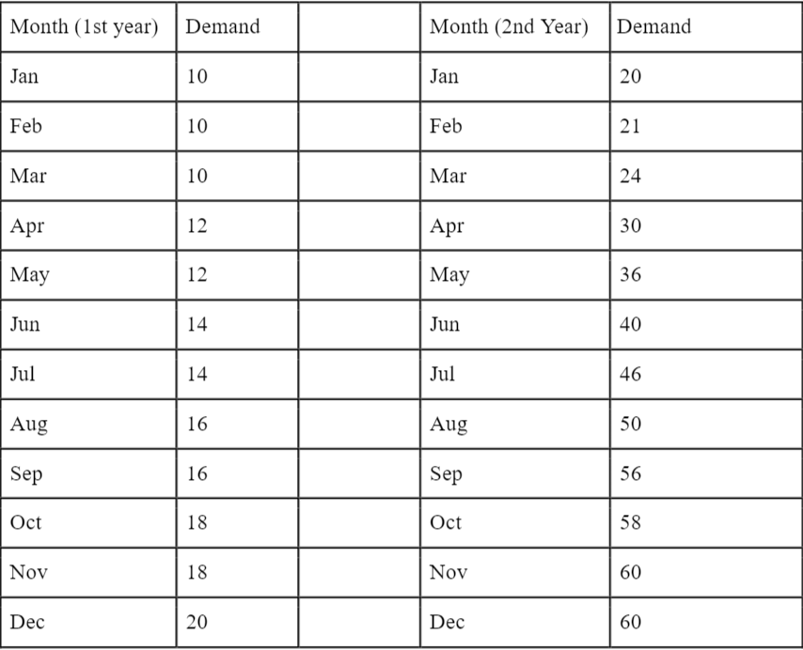
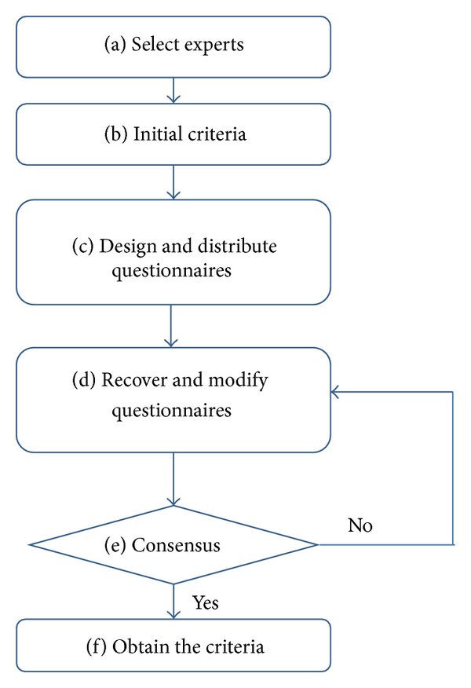
Forecasting
The result of Delphi method
Notes:
joe

Slide 8
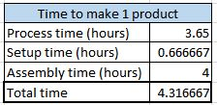

Manufacturing Time
Old Machine | 5.65 hrs
New Machine | 4.355 hrs
New Machine with Robotic Arm | 3.815 hrs
Total time to manufacture a product component was calculated with the summation of the following time component
Process time
Setup time
Assembly time
We tried to decrease the total time by using a new machine and robotic arm.
Notes:
joe

Slide 9
Time simulation for the machines
The product is having 20 components that are manufactured by Sharp themselves.
The production time were simulated using the DMG mori simulation tool.
The results were very similar to the actual one because they were calculated and verified by manufacturing the part along with it as well.
This provided all the information required for Time, PERT analysis and for EOQ models as well to calculate the optimum values to be ordered for the new machine.
Notes:
joe

Slide 10
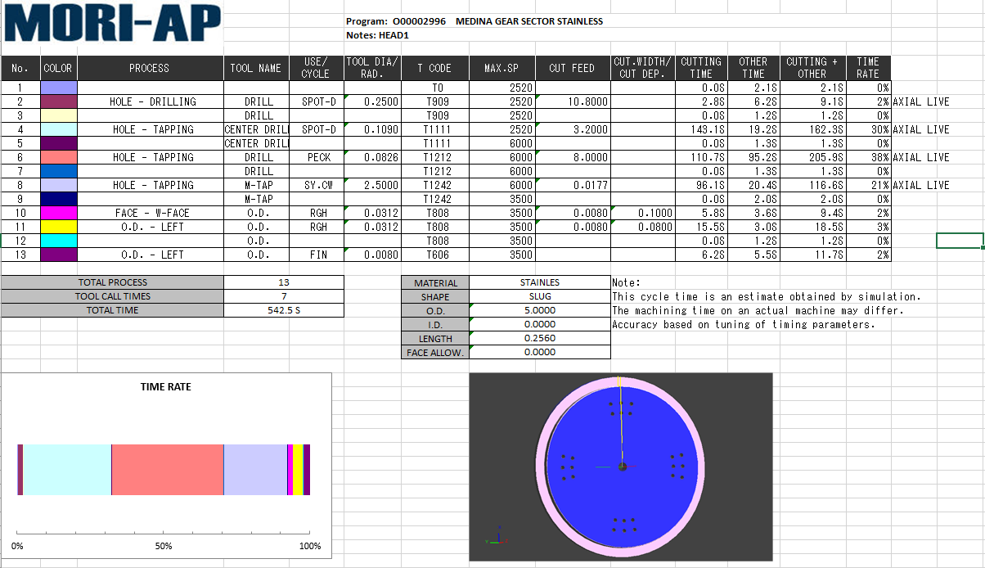
The simulation of one of the component of Actuator.

Slide 11
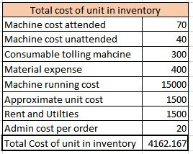

Manufacturing Costs
Old Machine | $4,255.5
New Machine | $4,165.85
New Machine with Robotic Arm | $4,127.05
Cost of machine (Attended and unattended)
Consumable tolling machines
Material expense
Machine running cost
Approximate unit cost
Rent and Utilities
Admin cost per order

Slide 12
Results - EOQ
Time to make 1 product
Decrease in time (%) | 10
Process time (hours) | 3.285
Decrease in time (%) | 10
Setup time (hours) | 0.6
Assembly time (hours) | 4
Total time | 3.885
Total cost of unit in inventory
Machine cost attended | 70
Machine cost unattended | 40
Consumable tolling machine | 300
Material expense | 400
Machine running cost | 15000
Approximate unit cost | 1500
Rent and Utilities | 1500
Admin cost per order | 20
Total Cost of unit in inventory | 4131.95
Critical time to reorder
Interest Rate | 0.06
Demand | 340
Q* | 7.406555819
T(in years) | 0.0217839877
T(in days) | 7.951155512
We used an EOQ model to calculate the optimal lot size, and when to begin production and re-ordering of new products
Using the data seen on the right, we determined the optimal lot size of 7.406 (8) units, and an optimal reorder time of every 7.95 (8) days.

Slide 13
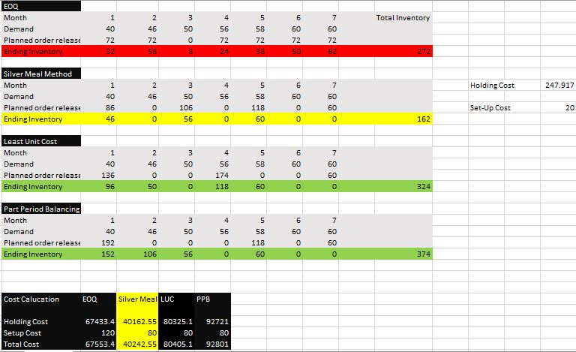
Lot Sizing
Notes:
As a part of Master Production Schedule plan to decide lot sizing, we have calculated the lot sizing and total cost using EOQ, silverman , LUC and PPB.Result shows that using Silver meal heuristic we are geting least cost so we proposed them to order according

Slide 14
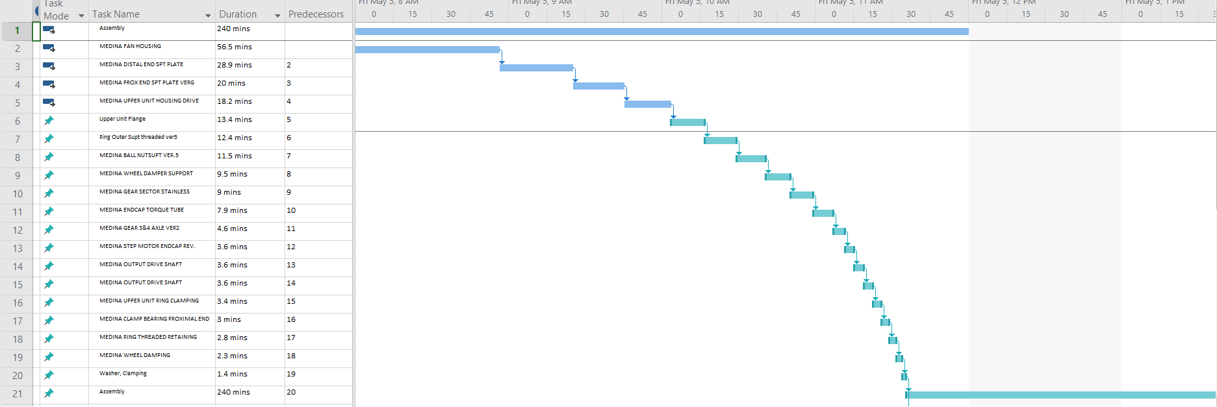
GANTT Chart

Slide 15

Results - Time analysis
A time analysis was conducted for each individual part of the product
This time analysis allowed us to determine the most critical process for the overall production - the one that is the most time consuming.
This was determined to be the milling of the Side Face for the Fan Housing - process #54 - which takes 1611.3 seconds, or 26.86 minutes. This is 48% of the total Fan Housing process time, and 13% of the TOTAL combined parts production time

Slide 16
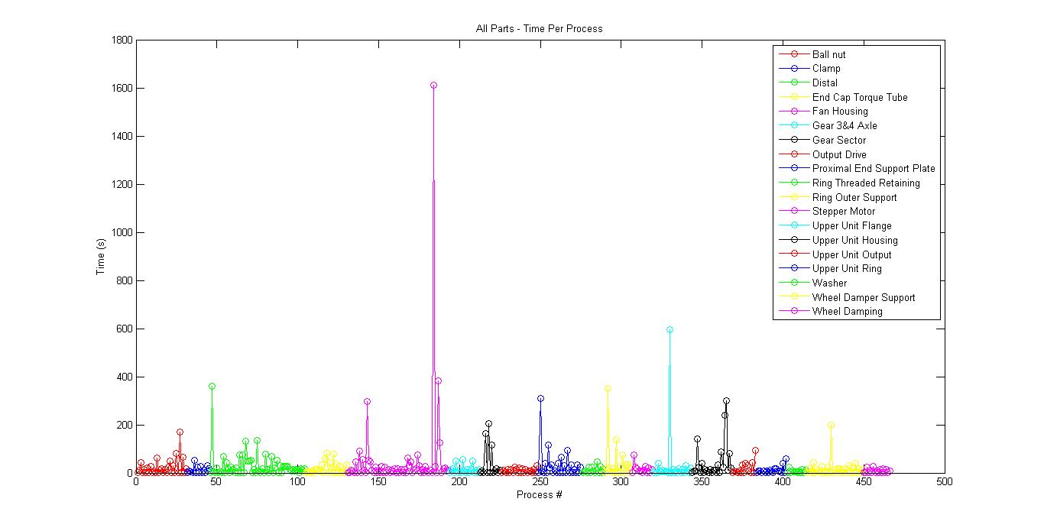
Results - Time analysis

Slide 17
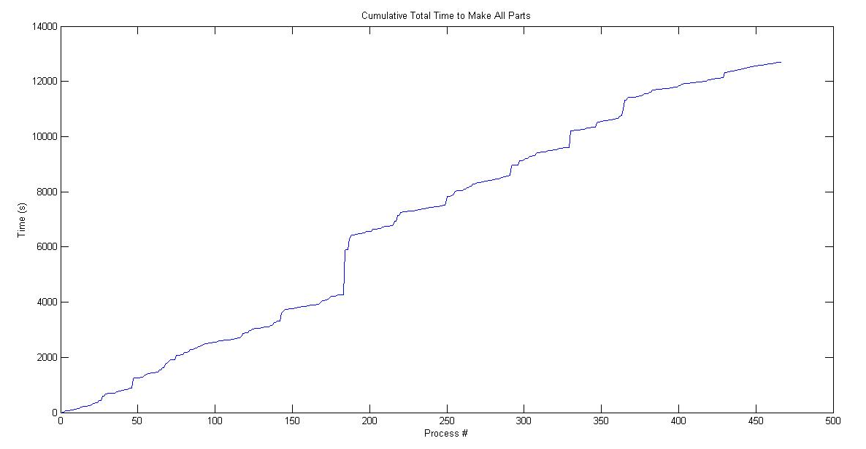
Results - Time analysis

Slide 18
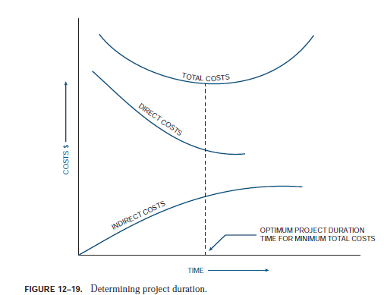
PERT analysis
The PERT analysis have the assumption that all activities start as soon as possible.
PERT analysis was used to check the maximum variation of time that can occur in the new machine compare to the old one.
There is the approximation that it can be faster in the range of 30-50%.
Thus, an Expected time was calculated using the project management formulas.

Slide 19
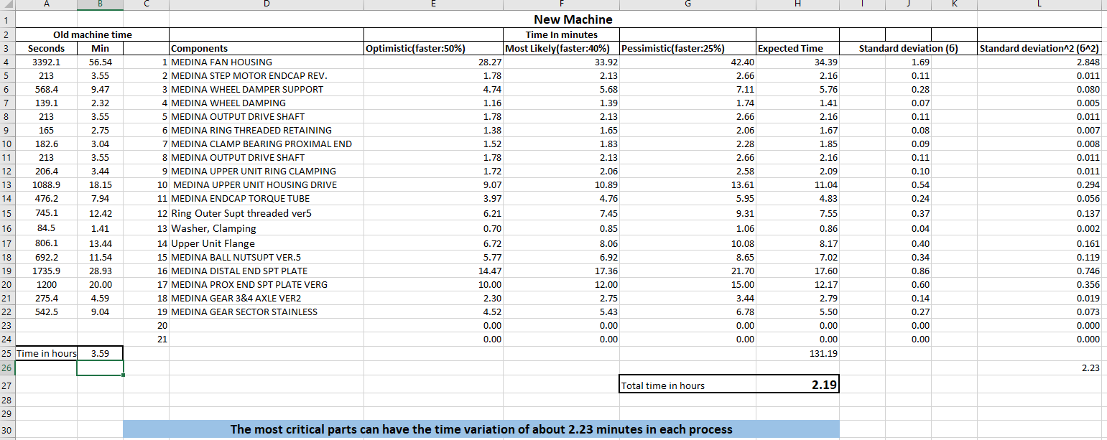
Results- PERT analysis

Slide 20
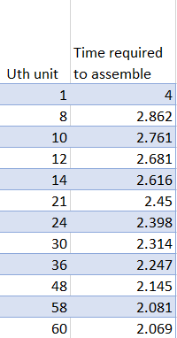
Learning curve
Learning Curve shows that as workers gain more experience, they become more skillful in their work and the process become very fast and production rate also increase.
The formula of learning curve is :
Y(u) = a*u^-b
Where,
  Y(u) = Time required to produce uth unit
  a = Time required to produce 1st unit
  b = rate at which marginal production rate is declined
Table x shows the time variation of the assembly.

Slide 21
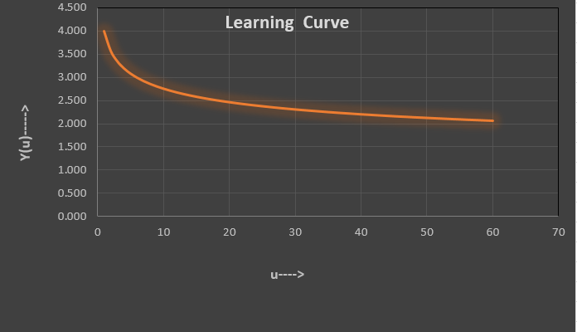
Learning Curve
Figure Y shows that these curves are accurately represented by an exponential relationship with time

Slide 22
Production cost
The cost that will be affecting considering all

Slide 23

Recommendations
Use of the robotic arm is suggested as it can reduce the time requirement by 5%
Use of new machine DMG Mori CTX beta 800 TC machine which reduced the production time by 10%.
Only need to hire 2 workers for machine operator and assemble the parts
Use of sawer and wire-EDM to make procedure faster
Keep consistent order of raw-materials to satisfy the demand
Use of high gradient coolant for better performance
Use of chips removing system during the operation which can reduce the time of production and labor work

Slide 24
Conclusion
Sharp has a very successful/interesting product coming soon that will certainly be in high demand
The production schedule and suggestions we have given will fulfill the demand that both we and Sharp expect for the company to have
Production time has been reduced, and a suggested inventory amount and re-order time has been given
Should Sharp follow our recommendations on the previous slide, they should expect to have a

Slide 25







Sup people !
Any Questions?

